Slide 1

333

Slide 2
Unit III: Exceptions
Exception handling, need for exception handling, exception types, using try-catch, multiple catch, nested try, finally, throw, throws, user defined exceptions

Slide 3
Java Exceptions
An event in program that disrupts normal flow of execution.
Trying to add elements to an array that is already full.
Trying to close a file that is not open.
Trying to access memory location that does not exist or is out of bounds.
Throwing an exception means:
Identify error in the method
Method creates an error object and hands it over to Java Runtime
Object contains information about the error, its type and state of the program when error occurred.

Slide 4
Difference between Error and Exception
Error | Exception
Occurs due to lack of system resources | Occurs due to programming error
Irrecoverable | Recoverable
Cannot be handled programmatically | Can be handled using “try-catch” construct
Program terminates abnormally | Program may display an appropriate message and continue
Classified as “unchecked” type | Classified as “unchecked” or “checked” type
Package: java.lang.Error | Package: java.lang.Exception

Slide 5
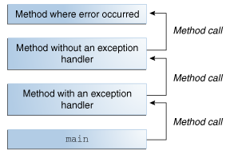
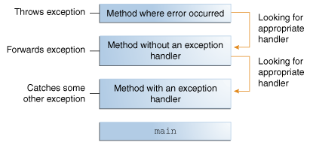
Exception Handling
Java Runtime attempts to find the ordered list of called methods to handle the “thrown” exception or error.
The list is called “call stack”.
Notes:
https://docs.oracle.com/javase/tutorial/essential/exceptions/index.html

Slide 6
The “try-catch” block
Java provides the “try-catch” construct to catch exceptions in any piece of code.
Syntax:
try{
//statements that may create an exception or error condition.
}
catch(<ExceptionName e>)
{
//Error messages and other statements to control the “damage”.
}
One “try” may accompany one or more “catches”.

Slide 7
The “finally” block
“finally” block is executed no matter whether an exception occurs.
For each “try” block there can be only one “finally” block.
Normally utilized to release system resources.
try{
...
...
}
catch{ //optional
...
...}
finally{ //optional
...}

Slide 8
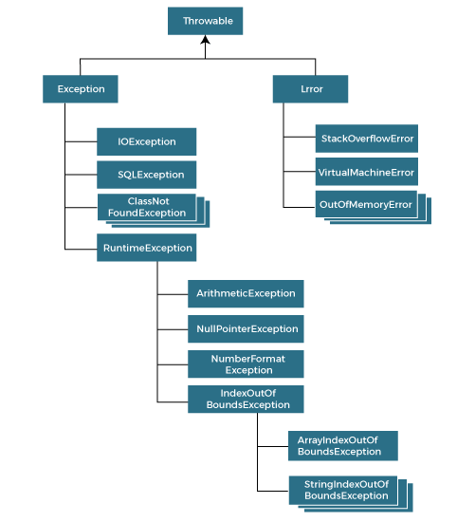
Exception Class Hierarchy

Slide 9
Defining a new Exception Class
Create a class that inherits from Exception. E.g. InvalidDepartmentException
Add the required constructor:
public InvalidDepartmentException(string message)
Create new exception messages.
Create appropriate classes, constructors and properties. E.g. an Employee class with empID, deptID and salary properties.
Throw the exception when appropriate. E.g. while defining an Employee class constructor that uses a property deptID, the constructor checks for valid deptID and throws the InvalidDepartmentException if deptID is invalid.
Catch the exception in calling method. E.g. in Main program while creating an Employee object.

Slide 10
User Defined Exceptions
There are 2 important keywords to use:
throw: The user defined exception is thrown when a certain condition fails.
E.g. if (deptID >= 5)
throw new InvalidDepartmentException(“Department ID should be less than 5”)
throws: A method or a constructor of a class “throws” the user defined exception. While defining the method or constructor, the “throws <exception>” clause needs to be added.
E.g. public Employee() throws InvalidDepartmentException

